Slide 1



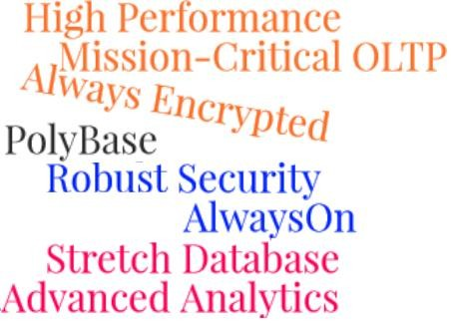
Session 19
SQL Server 2016
Security Upgrades and Working with JSON

Slide 2
Objectives
SQL Server
2016
Explain how to use SQL Server features to protect data at rest and in motion
Describe security enhancements in SQL Server 2016
Explain how to work with JSON data

Slide 3
Security Enhancements of SQL Server 2016 1-2
SQL Server 2016
Always Encrypted
Dynamic Data Mask
Transparent Data Encryption
Row–Level Security

Slide 4
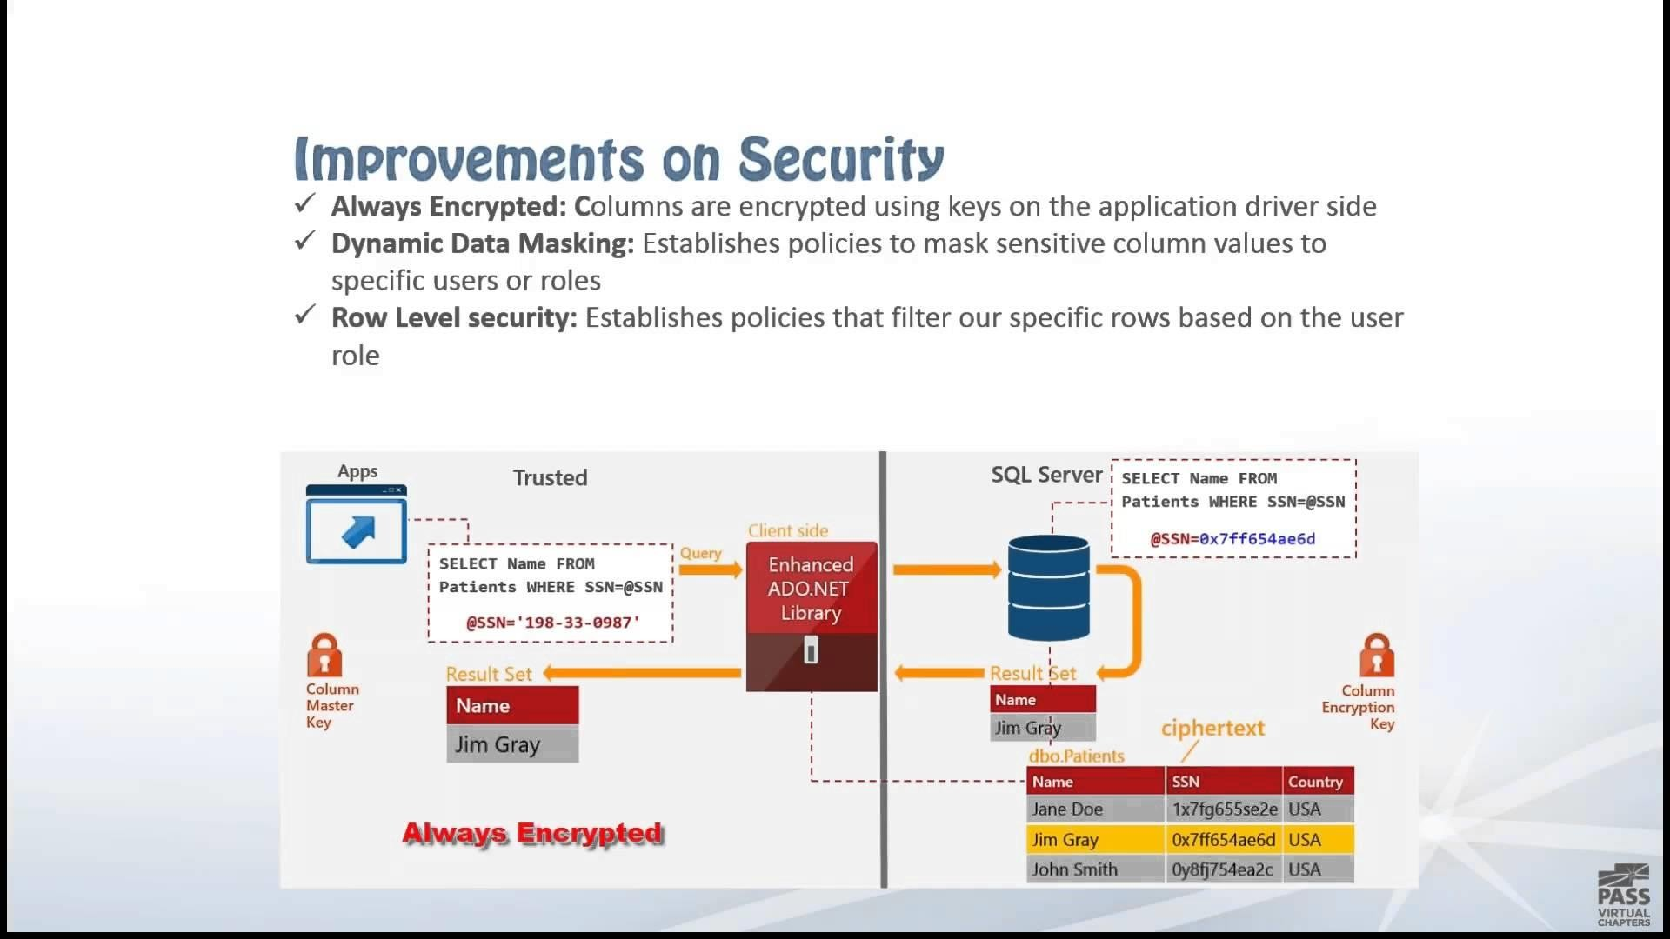
Security Enhancements of SQL Server 2016 2-2
SQL Server 2016
Following figure represents the Security Enhancements of SQL Server 2016:

Slide 5
Always Encrypted 1-2
SQL Server
2016
Always Encrypted is a feature that encrypts sensitive data inside client applications.
Randomized Encryption
Encryption is more secure
Data encrypted in a randomized manner
The two types of encryption supported by Always Encrypted are:
Deterministic Encryption
Same encrypted value generated for any specific plain text value

Slide 6
Always Encrypted 2-2
SQL Server
2016
Two types of keys used by Always Encrypted are:
Column Master Keys
Column Encryption Keys
Master keys protect column encryption keys
Sensitive data stored in database is encrypted with these types of keys

Slide 7
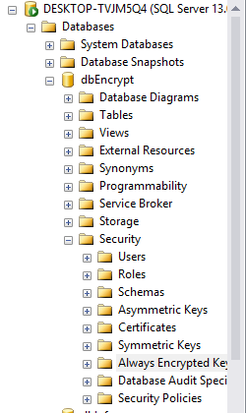
Getting Started with Always
SQL Server
Encrypted 1-8
2016
Step-by-step procedure to encrypt a database with Always Encrypted:
1. Expand database in SSMA, expand security, and then create Column Master key
Always Encrypted Keys item can be seen as shown:

Slide 8
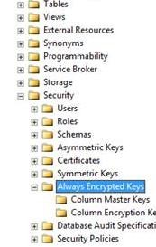
Getting Started with Always
SQL Server
Encrypted 2-8
2016
2. Expand ‘Always Encrypted Keys’ option
This gives more options as shown:

Slide 9
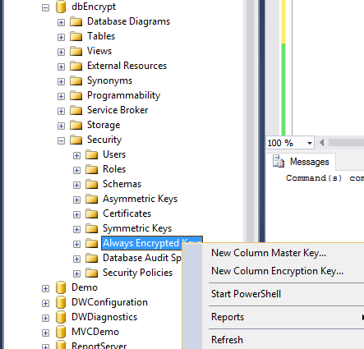
Getting Started with Always
SQL Server
Encrypted 3-8
2016
3. To create Column Master Key, click the ‘Column Master Keys’ item
This displays options as shown:

Slide 10
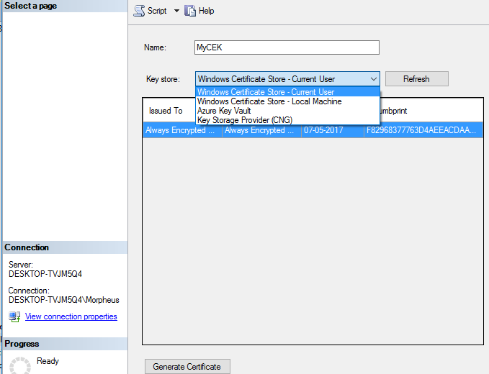
Getting Started with Always
SQL Server
Encrypted 4-8
2016
4. Click ‘New Column Master Key’ item in the drop-down list.
Screen is displayed as shown:

Slide 11
Getting Started with Always
SQL Server
Encrypted 5-8
2016
5. Enter a name for Column Master Key in the name section. Expand ‘Key store’
drop-down box.
Different key store options are displayed as shown:
The encrypted master key ‘MyCEK’ has been created.

Slide 12
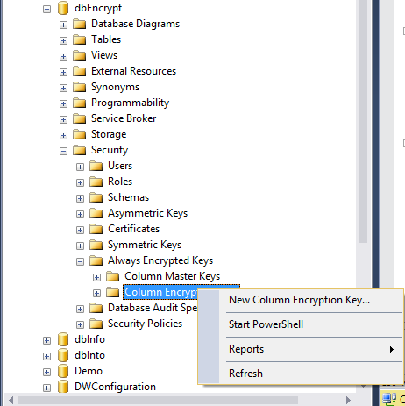
Getting Started with Always
SQL Server
Encrypted 6-8
2016
6. To create a column encryption key, right-click the ‘Column Encryption Key’ item in the Object Explorer and then select ‘New Column Encryption Key’
The screen is displayed as shown:

Slide 13
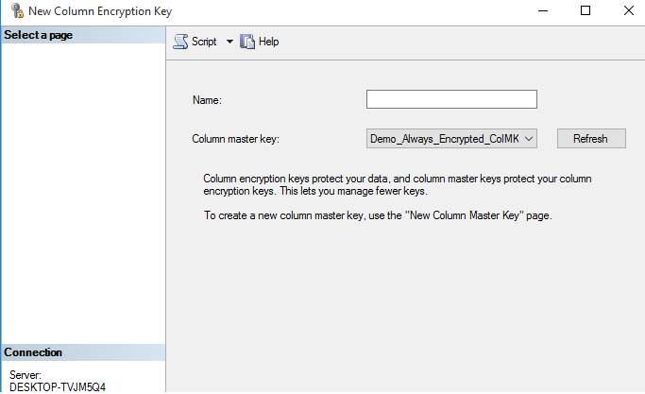
Getting Started with Always
SQL Server
Encrypted 7-8
2016
7. Then the ‘New Column Encryption Key’ is displayed

Slide 14
Getting Started with Always
SQL Server
Encrypted 8-8
2016
9. Create a new database. Then, create one or more tables with columns to be encrypted
CREATE DATABASE dbEncrypt USE dbEncrypt
CREATE TABLE Employees
(
EmpName nvarchar(60),
COLLATE Latin1_General_BIN2 ENCRYPTED WITH (COLUMN_ENCRYPTION_KEY
Demo_Always_Encrypted_ColMKey, ENCRYPTION_TYPE = RANDOMIZED, ALGORITHM = 'AEAD_AES_256_CBC_HMAC_SHA_256'),
UID varchar(11)
COLLATE Latin1_General_BIN2 ENCRYPTED WITH (COLUMN_ENCRYPTION_KEY =
Demo_Always_Encrypted_ColMKey,
ENCRYPTION_TYPE = DETERMINISTIC,
ALGORITHM =
'AEAD_AES_256_CBC_HMAC_SHA_256'),
Age int NULL
); GO
8. Enter the name of new ‘Column Encryption Key’ , which is
‘Demo_Always_En crypted_CEK’.
Select ‘Column Master Key’ from drop-down menu, identify the name and master key, then press OK to create column encryption key

Slide 15
Transparent Data Encryption
SQL Server
2016
A technique used to encrypt the SQL Server and Azure SQL database data files.
TDE
Accomplishes real- time I/O encrypting and decrypting of log files
Protects data at rest (Data not in use)
Provides file level encryption
Oracle and Microsoft have adapted TDE technology to encrypt
database files.

Slide 16
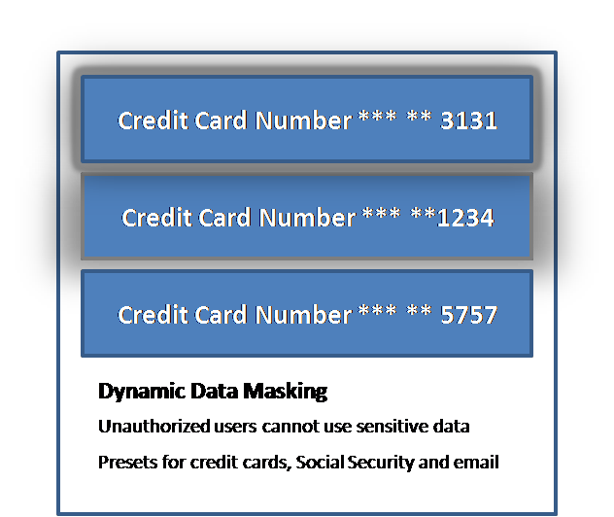
Dynamic Data Masking 1-6
SQL Server
2016
Dynamic Data Masking is a feature for protecting sensitive data.
Prevents data from unauthorized access.
Hides the sensitive query result set
and the keeps the database
unchanged.
Sensitive data can be masked without changing existing queries.
Use DDM in co-ordination with other
security features such as auditing,
encryption, and row-level security.

Slide 17
Dynamic Data Masking 2-6
SQL Server
2016
Limitations and restrictions of DDM
The column types that cannot have a masking rule defined on them are:
Encrypted columns
Filestream COLUMN_SET
Sparse column that is part of a COLUMN_SET Computed column
FULLTEXT index key

Slide 18
Dynamic Data Masking 3-6
SQL Server
2016
Creating a DDM
CREATE TABLE NewGroup
(UID int IDENTITY PRIMARY KEY,
FNM varchar(100) MASKED WITH (FUNCTION = 'partial(1,'XXXXXXX',0)') NULL,
FatherName varchar(100) NOT NULL,
Mobile varchar(12) MASKED WITH (FUNCTION = 'default()') NULL, PersonalEmail varchar(100) MASKED WITH (FUNCTION = 'email()') NULL); INSERT NewGroup (FNM, FatherName, Mobile, PersonalEmail) VALUES ('Johnson', 'Flanagan', '12345688', 'JohnnsonFlan@yahoo.com'),
('Rossell', 'Geller', '76543218', 'RossGeller@hotmail.com'), ('Brook', 'Darwin', '88956585', 'Brookdarwin@gmail.com'); SELECT * FROM NewGroup

Slide 19
Dynamic Data Masking 4-6
SQL Server
2016
Granting SELECT Permission
CREATE USER DemoUser WITHOUT LOGIN;
GRANT SELECT ON NewGroup TO DemoUser;
EXECUTE AS USER = 'DemoUser';
SELECT * FROM NewGroup;
REVERT;
The data is changed from:
1 John Flanagan 12345688 Johnson@yahoo.com To:
1 JXXXXXXX Flanagan xxxx JXXXX@XXXX.com

Slide 20
Dynamic Data Masking 5-6
SQL Server
2016
Adding or Editing a Mask on an Existing Column
Use ALTER TABLE command to
Add a mask to the column already existing in the table
Modify the column mask
A masking function is added to the FatherName column as shown
ALTER TABLE NewGroup
ALTER COLUMN FatherName ADD MASKED WITH (FUNCTION
= 'partial(2,'XXX',0)');
The masking function on column FatherName can be modified as
ALTER TABLE NewGroup
ALTER COLUMN FatherName varchar(100) MASKED WITH (FUNCTION = 'default()');

Slide 21
Dynamic Data Masking 6-6
SQL Server
2016
Dropping a DDM
The mask on the FatherName column created earlier can be removed as shown
ALTER TABLE NewGroup
ALTER COLUMN FatherName DROP MASKED;

Slide 22

Row-Level Security 1-2
SQL Server
2016
Row–Level security applies security rules on per row basis.
Implementation
Using a special inline table valued function is used
Simulating stored procedures or
table valued functions
Ensure that the rules are not bypassed
Practical Effects
Row-Level security users will not be able to view the rows for which they do not have permission
A Full Text Search to the column can leak the data.
✕

Slide 23
Row-Level Security 2-2
SQL Server
2016
To view the statistics on a secured column, the user should belong to one of the following roles:
Table owner
Member of sysadmin fixed server role db_ddladmin fixed database role
db_owner fixed database role✕

Slide 24
Opening JSON with OPENJSON() 1-6
SQL Server
2016
JSON is an open standard that is used to send out data between Web application and a server.
Uses text to transmit data objects in the form of attribute-value
pairs.
Used as a substitute to XML.
OPENJSON is a built-in Table-valued Function (TVF) and does the following:
Locate an array of JSON objects
Seeks into some JSON text Iterate through array elements
Outputs one row for each array element

Slide 25
Opening JSON with OPENJSON() 2-6
SQL Server
2016
OPENJSON will transform the JSON text generated with FOR JSON clause back to relational form.
Two types of OPENJSON TVF are:
OPENJSON with predefined result: The user can define schema for the table to be returned and the mapping rules.
OPENJSON without return schema: Here the output will be as key-
value pairs.

Slide 26
Opening JSON with OPENJSON() 3-6
SQL Server
2016
OPENXML is used as the framework for OPENJSON. Though the usage looks identical, there are elemental differences:
OPENJSON | OPENXML
Accepts text input Drawback: When two identical JSON text are passed to different OPENJSON calls, they will be parsed each time. | Accepts handle.
Return row with (key, value) schema. | Parses entire XML tree without distinct schema. Returns a flat table with all nodes.

Slide 27
Opening JSON with OPENJSON() 4-6
SQL Server
2016
Converting JSON to Rowset Data Using the OPENJSON Function: The OPENJSON rowset function is used to convert the data to relational format. It returns following three values:
Key: Key is either the index of an array element or property name
within the object.
Value: Value specifies the array element value or the value of the property within the object.
Type: The data type of the value. This is depicted numerically as shown:
Numeric Value | Data Type
0 | null
1 | string
2 | int
3 | True or false
4 | array
5 | object

Slide 28
Opening JSON with OPENJSON() 5-6
SQL Server 2016
Converting JSON to Rowset Data Using the OPENJSON Function: The user can allocate JSON snippet to a variable and then use OPENJSON function to call the variable as shown in the example:
DECLARE @JSON NVARCHAR (MAX) = N'
{
'InitialName': null, 'MaidenName': 'Dawson ', 'UID': 9988776655,
'Current': false,
'Skills': ['DevOps', 'Python', 'Perl'],
'Region': {'Country':'USA','Territory':'North America'}
}';
SELECT * FROM OPENJSON (@json);

Slide 29
Opening JSON with OPENJSON() 6-6
SQL Server 2016
The JSON snippet consists of a single object with a property for each data type. The SELECT statement utilizes OPENJSON function with the FROM clause to fetch JSON data as rowset. This is as shown:
Key | Value | Type
InitialName | Null | 0
MaidenName | Dawson | 1
UID | 998776655 | 2
Current | False | 3
Skills | ['DevOps','Python','Perl'] | 4
Location | {'Country':'USA','Territory':'North America'} | 5
Note : The type’ column signifies the data type for each value. The ‘key’ skills is an array that consists of all array elements in the result set. The ‘key’ location is an object that consists of all the object properties.
.

Slide 30
Summary
SQL Server
2016
Security enhancements in SQL Server 2016 are Always Encrypted, Dynamic Data Mask, Transparent Data Encryption, and Row-Level security.
Always Encrypted feature protects sensitive data .The encrypted keys are hidden from SQL database.
Randomized encryption and deterministic encryption are the two types of encryption supported by Always Encrypted.
The TDE technology encrypts database files, providing file level
encryption. TDE protects data at rest.
Dynamic data masking masks the data and prevents it from unauthorized access.
Row –Level security applies security rules on per row basis.
JSON is an open standard that is used to exchange data between Web
application and a server.
The built-in OPENJSON rowset function converts the data to relational format.
© Aptech Lt.
SQL Server Inside Out/ Session 19
30

